Slide 1
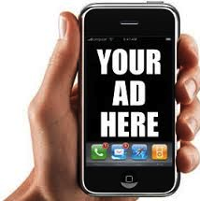
Ad VANTAGE
MOBILE AD revenue optimizer

Slide 2
Objective
Predict revenue of the ad receiving from ad network.
So the publisher can optimize revenue.

Slide 3
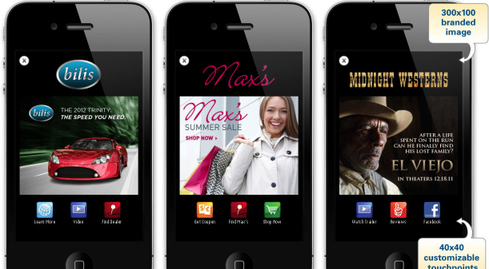
Mobile Advertising Ecosystem
Show ads and make $$$
Apps
Optimize monetization for Apps
Ad Platforms
AD Vantage predicts:
Ad REVENUE
Send ads to apps
Ad Networks
Send ads to Ad Networks
Advertisers

Slide 4
Process
Data: Real mobile ad log from one day, from multiple ad networks, sent to publishers.
Models: Logistic, Random Forest.
Tools: Python, SQL, MRJobs
Predict the next ad revenue received based on device, app, user, location, timestamp and ads themselves. All extracted from ad tags.

Slide 5
Findings
Accuracy
Interesting facts

Slide 6
Screenshot
Input: app attributes.
Output: likely ad revenue.

Slide 7
Next Steps
Apply pipeline to various ad networks.
Given publisher (app) parameters, choose the best ad network to request ad from.
Improve accuracy.
More granular features and inferences.

